Slide 1
Activity & Sequence Diagram
1

Slide 2
Group Members
*Ismail Hasan Sarker
*ID: 181-15-1815
Israt Jahan
ID: 181-15-1932
Farzana Akter Tonny
ID: 181-15-2042
Tanvirul Islam
ID: 181-15-1946
Md. Al-Amin
ID: 181-15-1951

Slide 3
Our Topics For Today:
>> Activity Diagram Introduction
>> One Example of Activity Diagram
>> Sequence Diagram Introduction
< MY CONTRIBUTION >
>> Sequence Diagram’s Notations
</ MY CONTRIBUTION >
>> Example of Sequence Diagram

Slide 4
Sequence Diagram’s Notations
Frame
Guards
Lifeline
Alternatives
Activation
Option
Message
Parallel
Loop

Slide 5
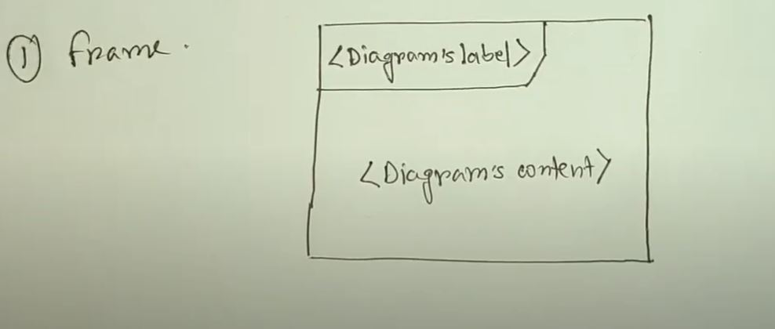
Frame

Slide 6
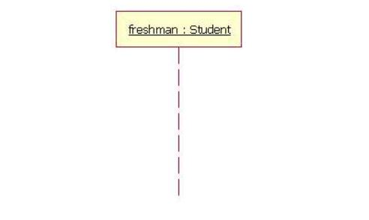
Lifeline

Slide 7
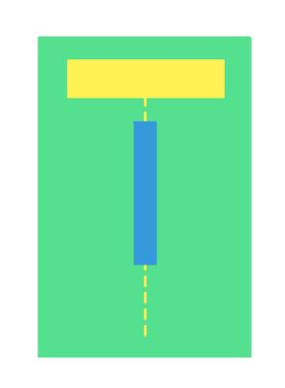
Activation

Slide 8
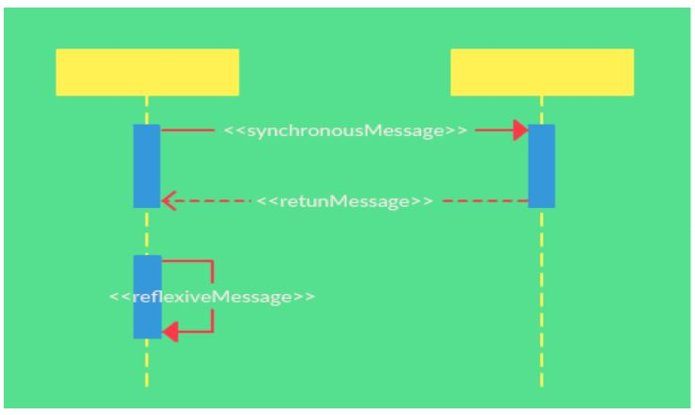
Message

Slide 9
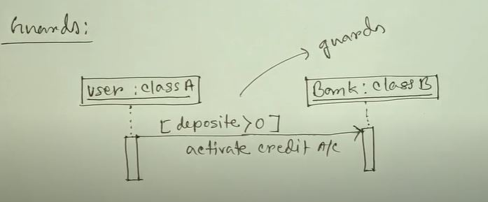
Guards

Slide 10
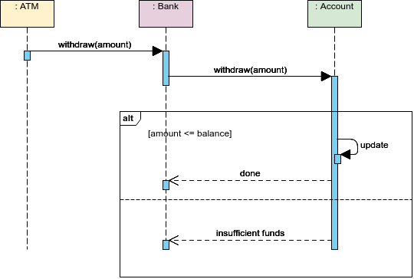
Alternatives

Slide 11
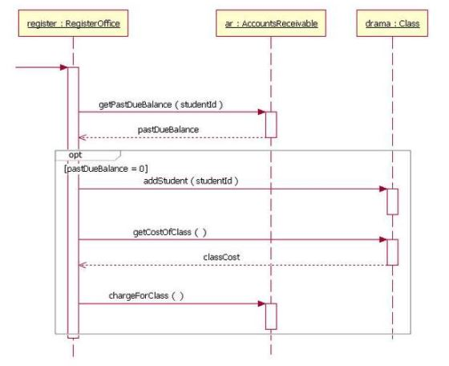
Option

Slide 12
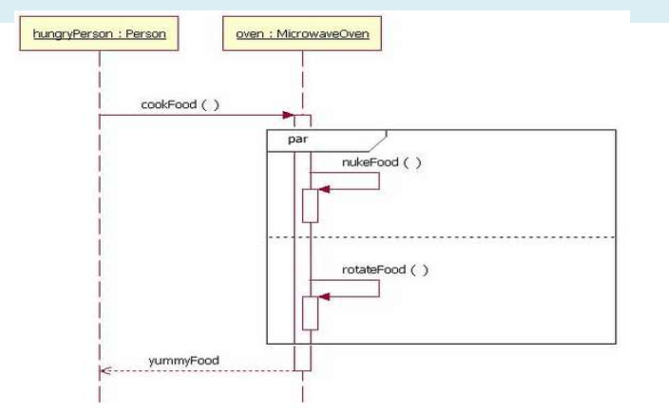
Parallel

Slide 13
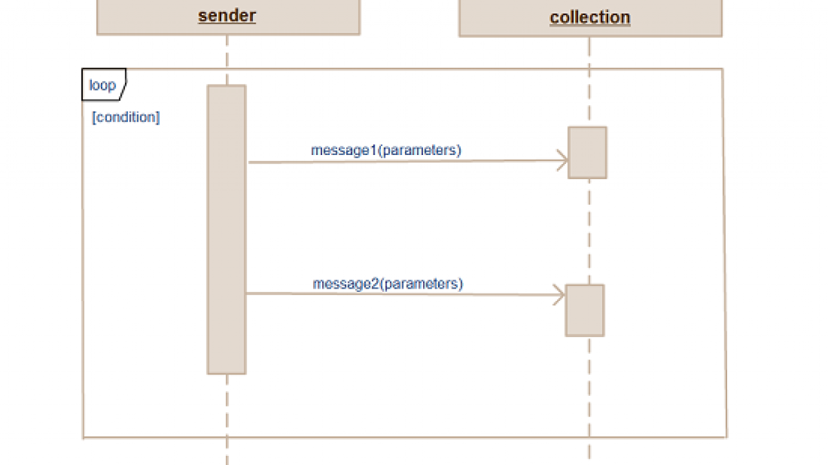
Loop

Slide 14
CREDITS
Special thanks to all the people who helped me to do this and thanks to those sites from whom I’ve collected information and template from:
Presentation template by slidecarnival
Pictures from google, slideshare, youtube.

Slide 15
THANKS!
Any questions?
You can find me at:
https://github.com/IsmailHasanSarker44
ismail15-1815@diu.edu.bd

